Slide 1

NEWS GLOBAL
News From All Over The World
Presented By:
K Virinchi
Metta Roja
HariChandana Samudrala

Slide 2
Objective
To create a news application that would
Provide news articles from all over the world.
Allow user to add news articles to favorite list.
Allow user to search for news articles.

Slide 3
Technology And Tools
Backend
Tools
Frontend
Technologies
Tools
----------------------------------------
Spring Boot With Hibernate.
Mongo dB, MySQL.
HTML 5, CSS 3.
Bootstrap 4
Angular 8.
Spring Tool Suite-4-4.7.0.
Visual Studio Code,
MySQL workbench,
Mongo DB

Slide 4
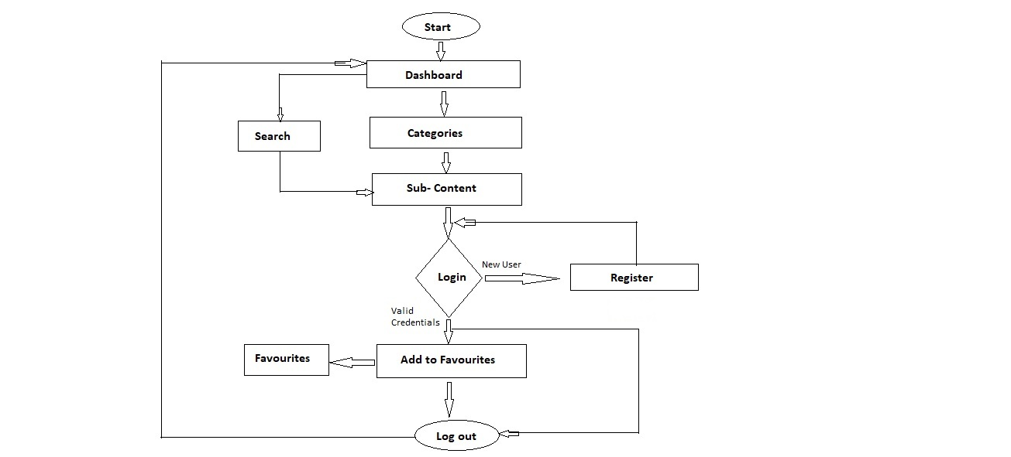
Flowchart

Slide 5

Modules
Signup
Login
Home
Favorite
Categories
Search
Logout

Slide 6
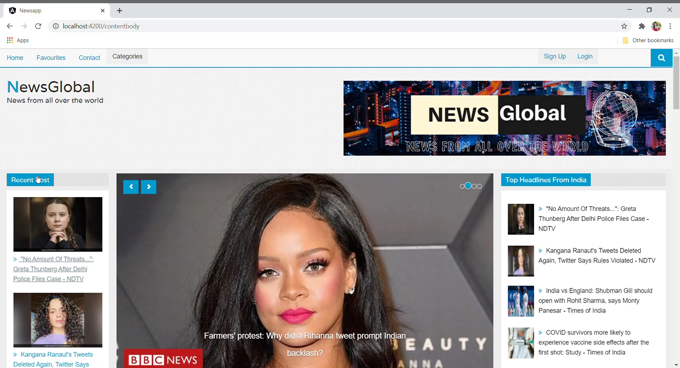
DASHBOARD

Slide 7
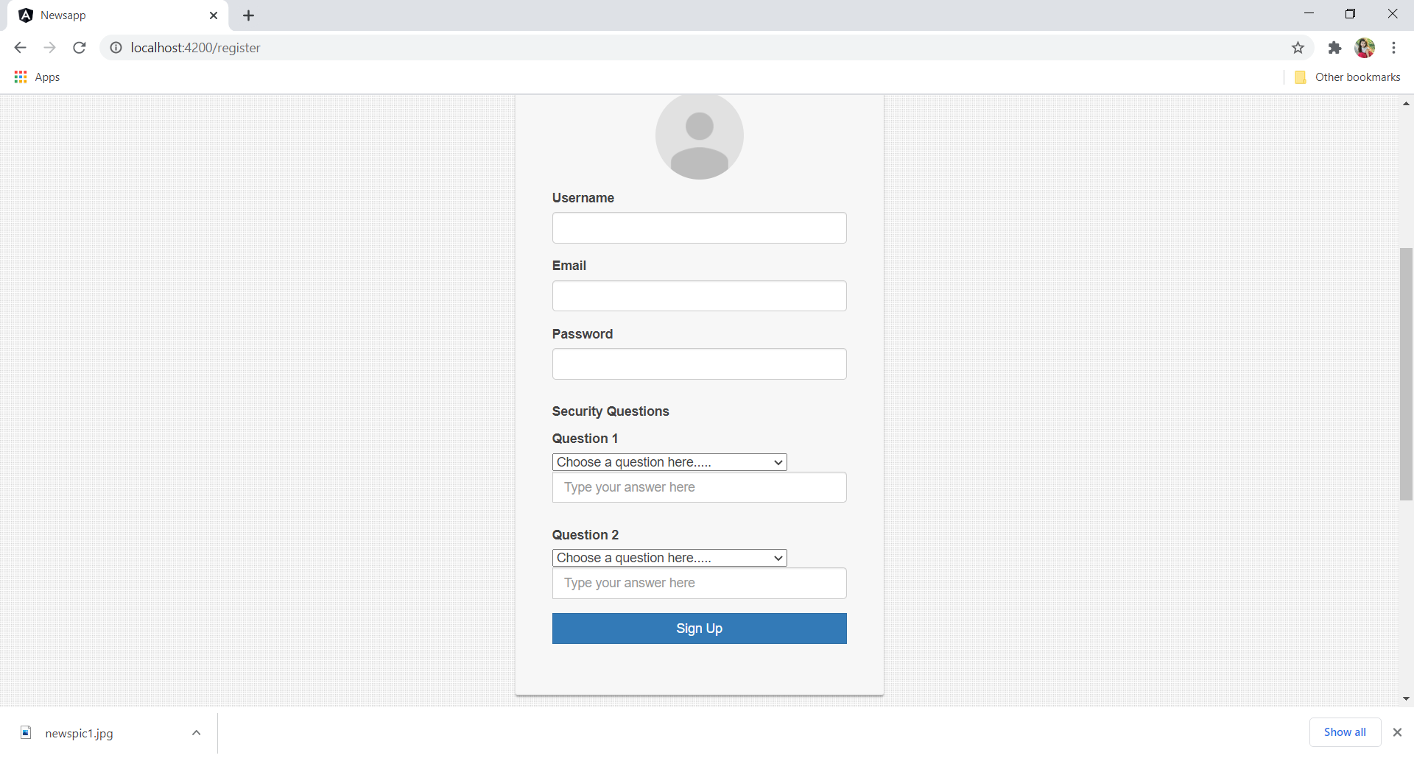
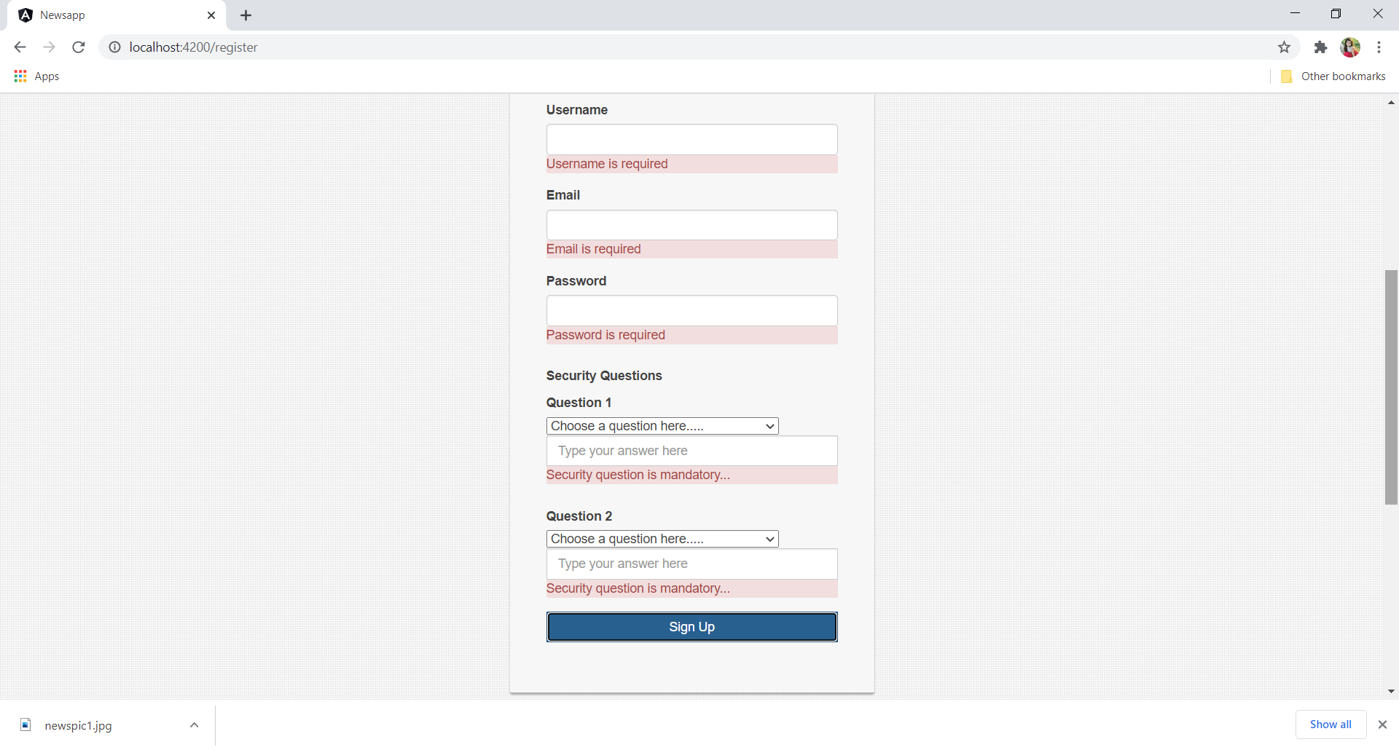
REGISTER PAGE
Registeration form
With validations

Slide 8
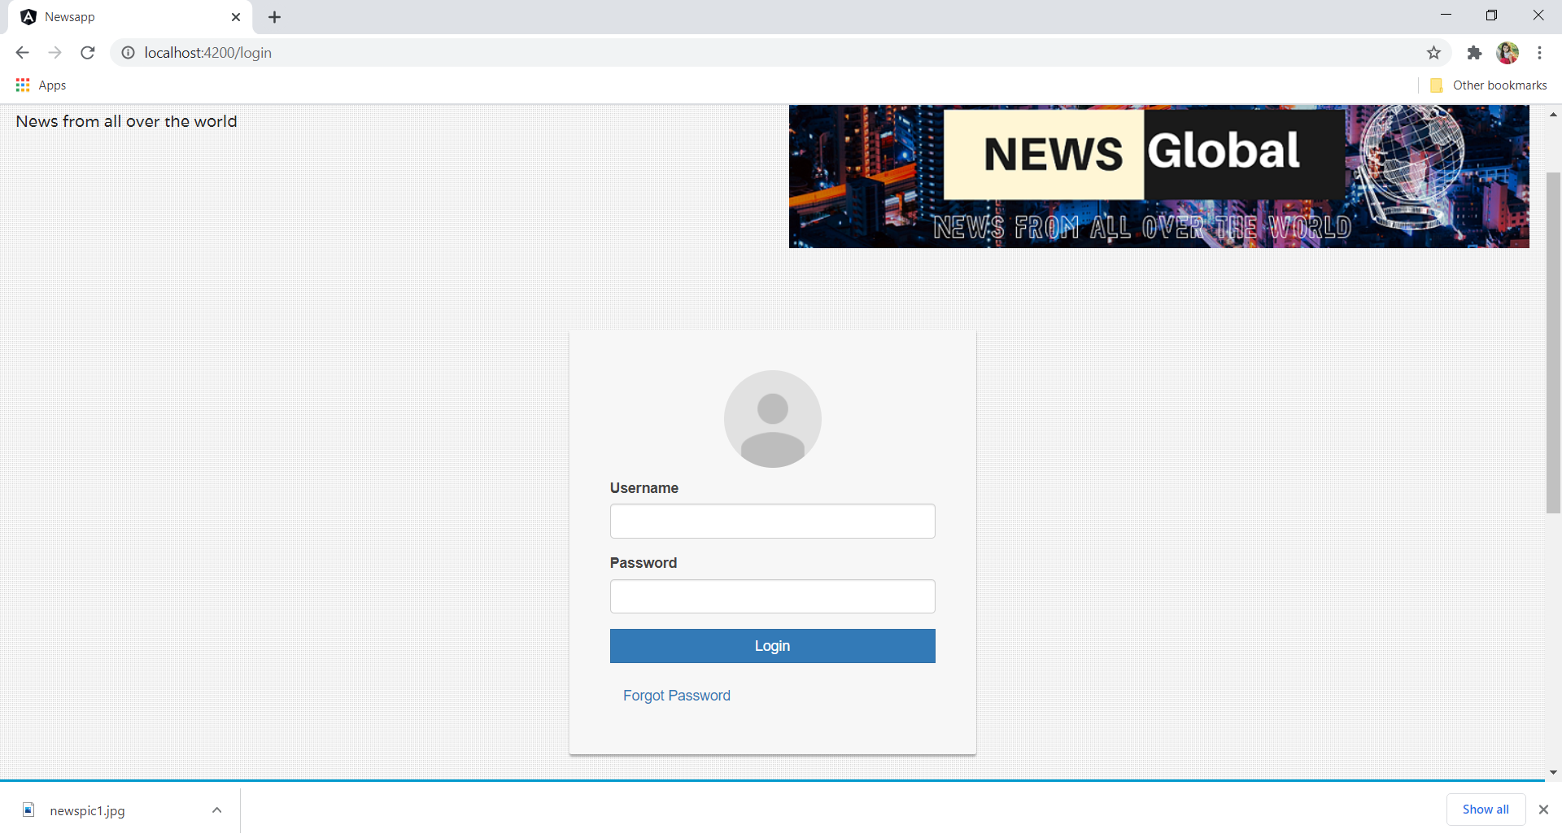
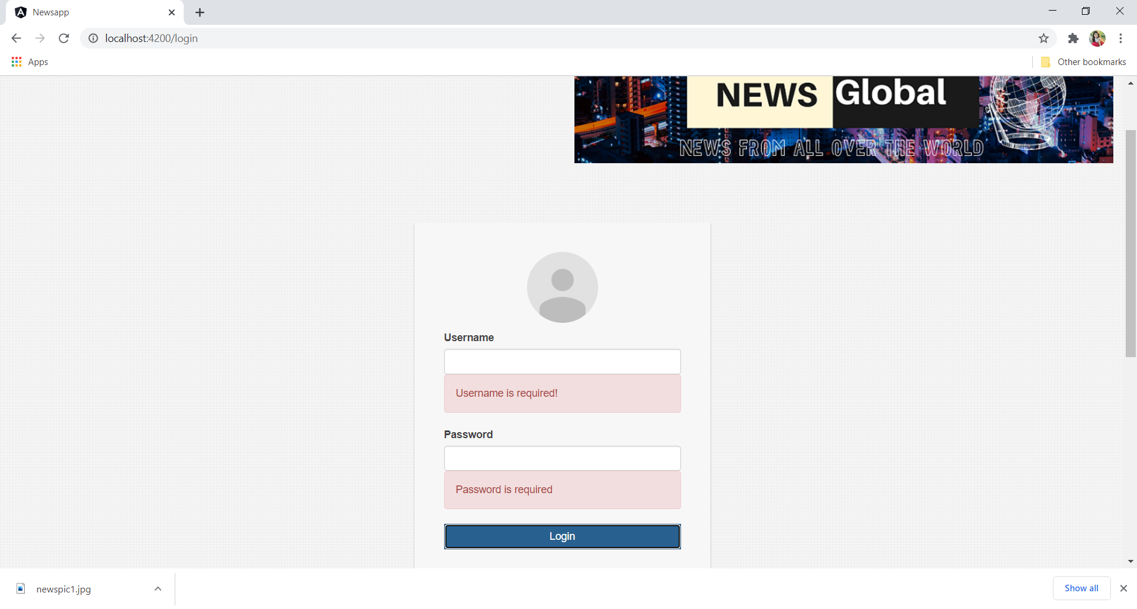
LOGIN PAGE
Login form
Validations

Slide 9
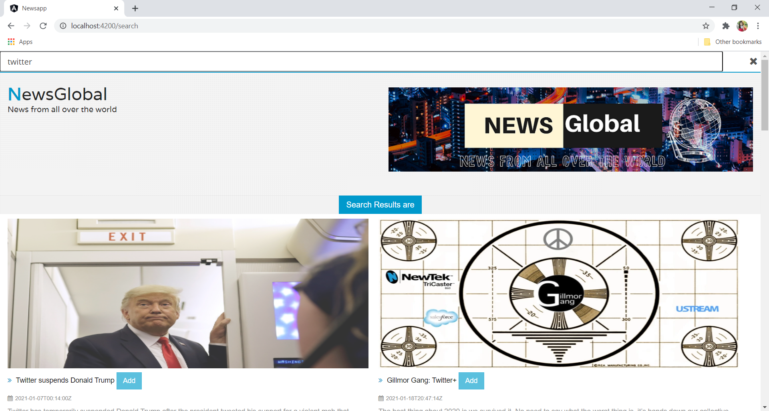
SEARCH

Slide 10
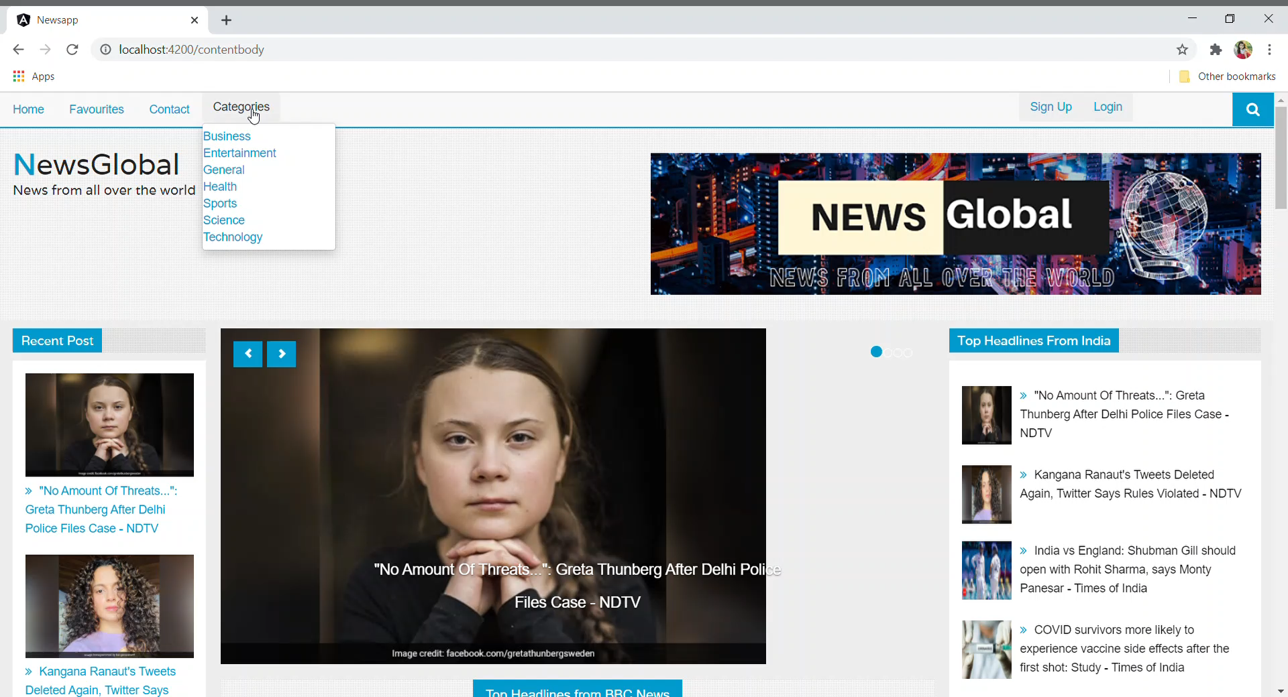
Link Navigation

Slide 11
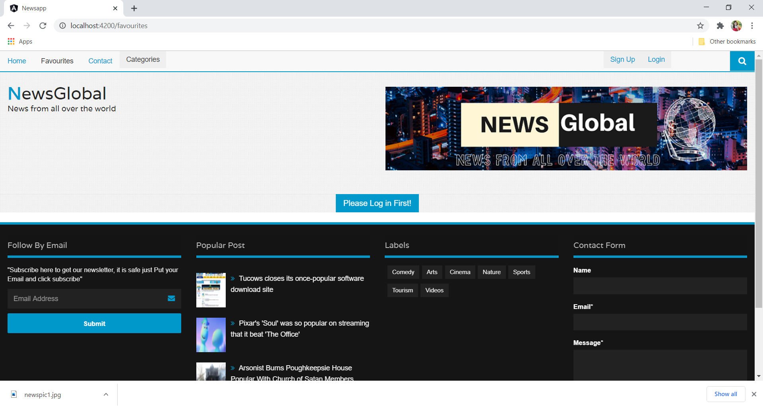
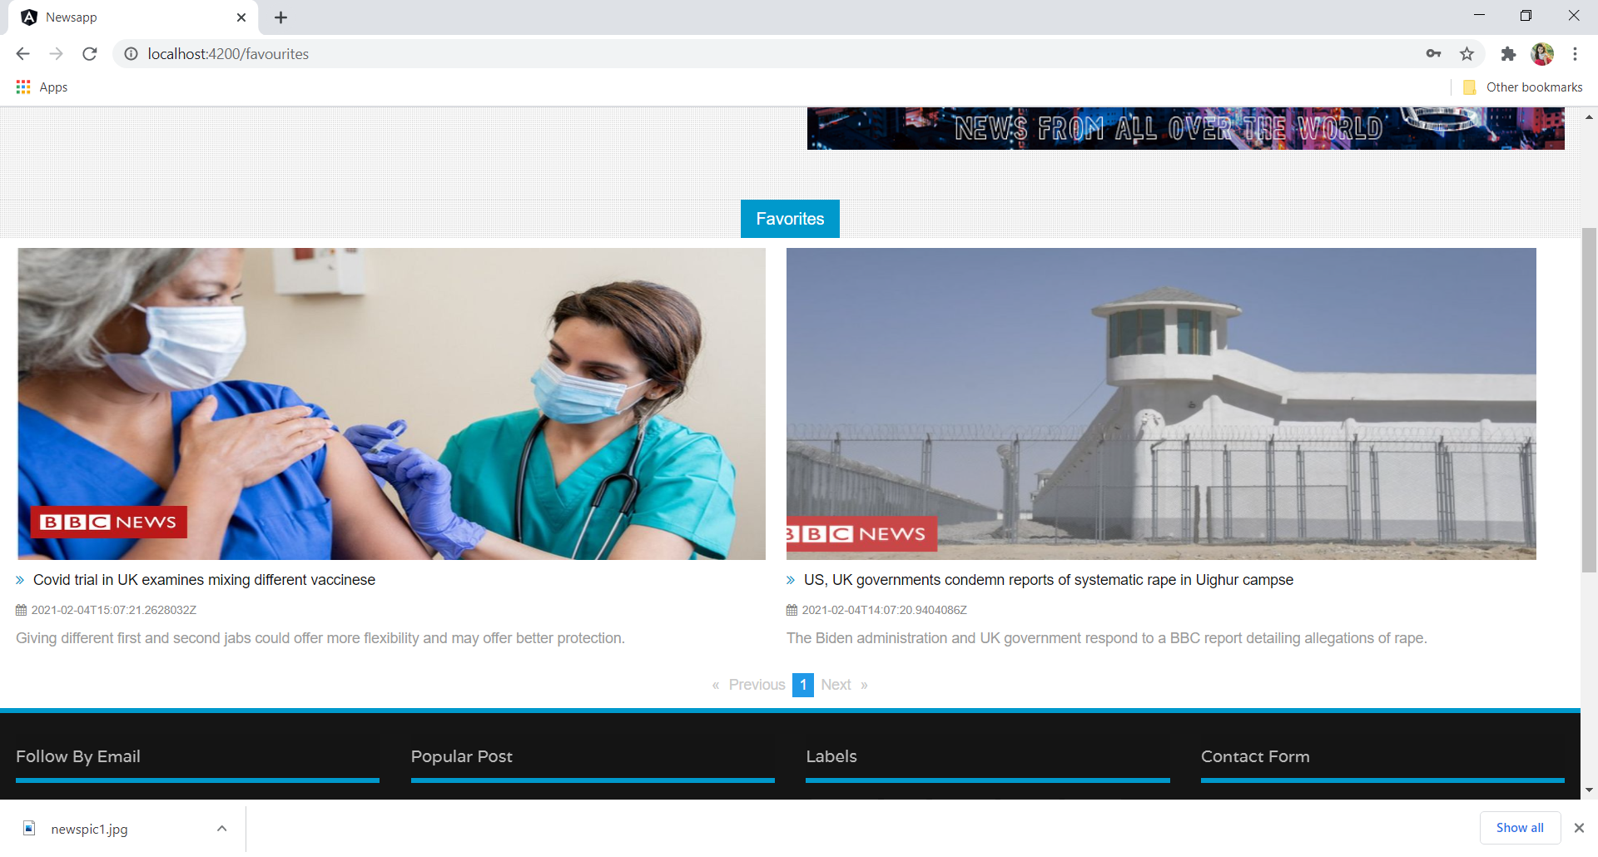
FAVOURITES
Before login
After login

Slide 12
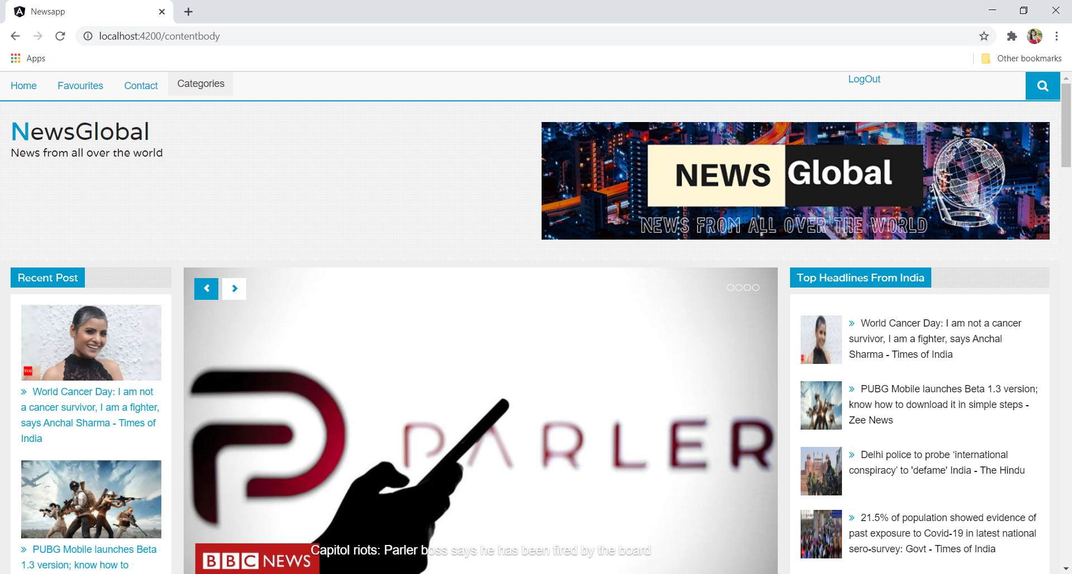
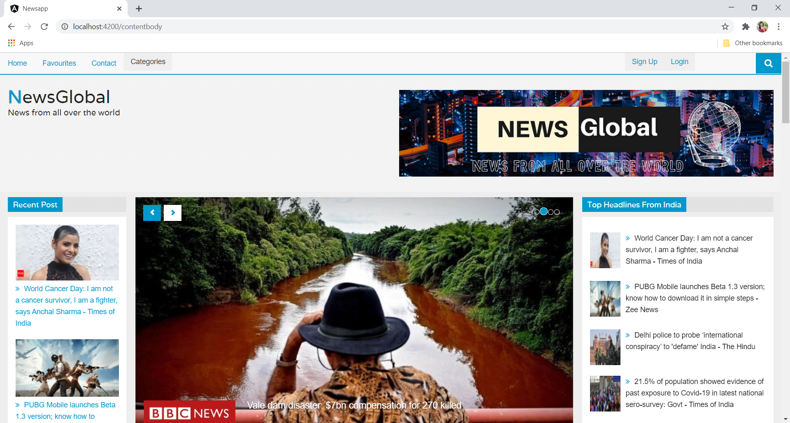
LOGOUT
Logout
After logout

Slide 13
Conclusion
News global application provides all users needed functionalities like searching News articles, adding the news articles to favorites, top headlines, recent posts and also secure user authentication.

Slide 14
Thank You

